Slide 1

Introduction to Machine Learning Topic 2 – A Machine Learning project? (HO Ch. 2 / ISL Ch. 2)
Master in Quantitative Economic Analysis MQuEA
Javier Bas
Universidad Autónoma de Madrid
2022/2023

Slide 2
Outline
Where to get data from?
A Machine Learning project
Evaluate the Project
Set up your environment
The workflow of a project
Setting up
Getting the data
Visualizations
Preparing data
Training model(s)
Fine-tune the best model
Case study: California Housing Prices
Master in Quantitative Economic Analysis MQuEA
Universidad Autónoma de Madrid

Slide 3
Where to get data from?
Popular open data repositories
OpenML.org (https://openml.org/)
Kaggle.com (https://kaggle.com/datasets)
PapersWithCode.com (https://paperswithcode.com/datasets)
UC Irvine Machine Learning Repository (https://archive.ics.uci.edu/ml/datasets.php)
Amazon’s AWS datasets (https://registry.opendata.aws/)
TensorFlow Datasets (https://tensorflow.org/datasets)
Meta portals (they list open data repositories)
DataPortals.org (https://dataportals.org/)
OpenDataMonitor.eu (https://opendatamonitor.eu/)
Other pages listing many popular open data repositories
Wikipedia’s list of Machine Learning datasets (https://en.wikipedia.org/wiki/List_of_datasets_for_machine-learning_research)
Master in Quantitative Economic Analysis MQuEA
Universidad Autónoma de Madrid

Slide 4
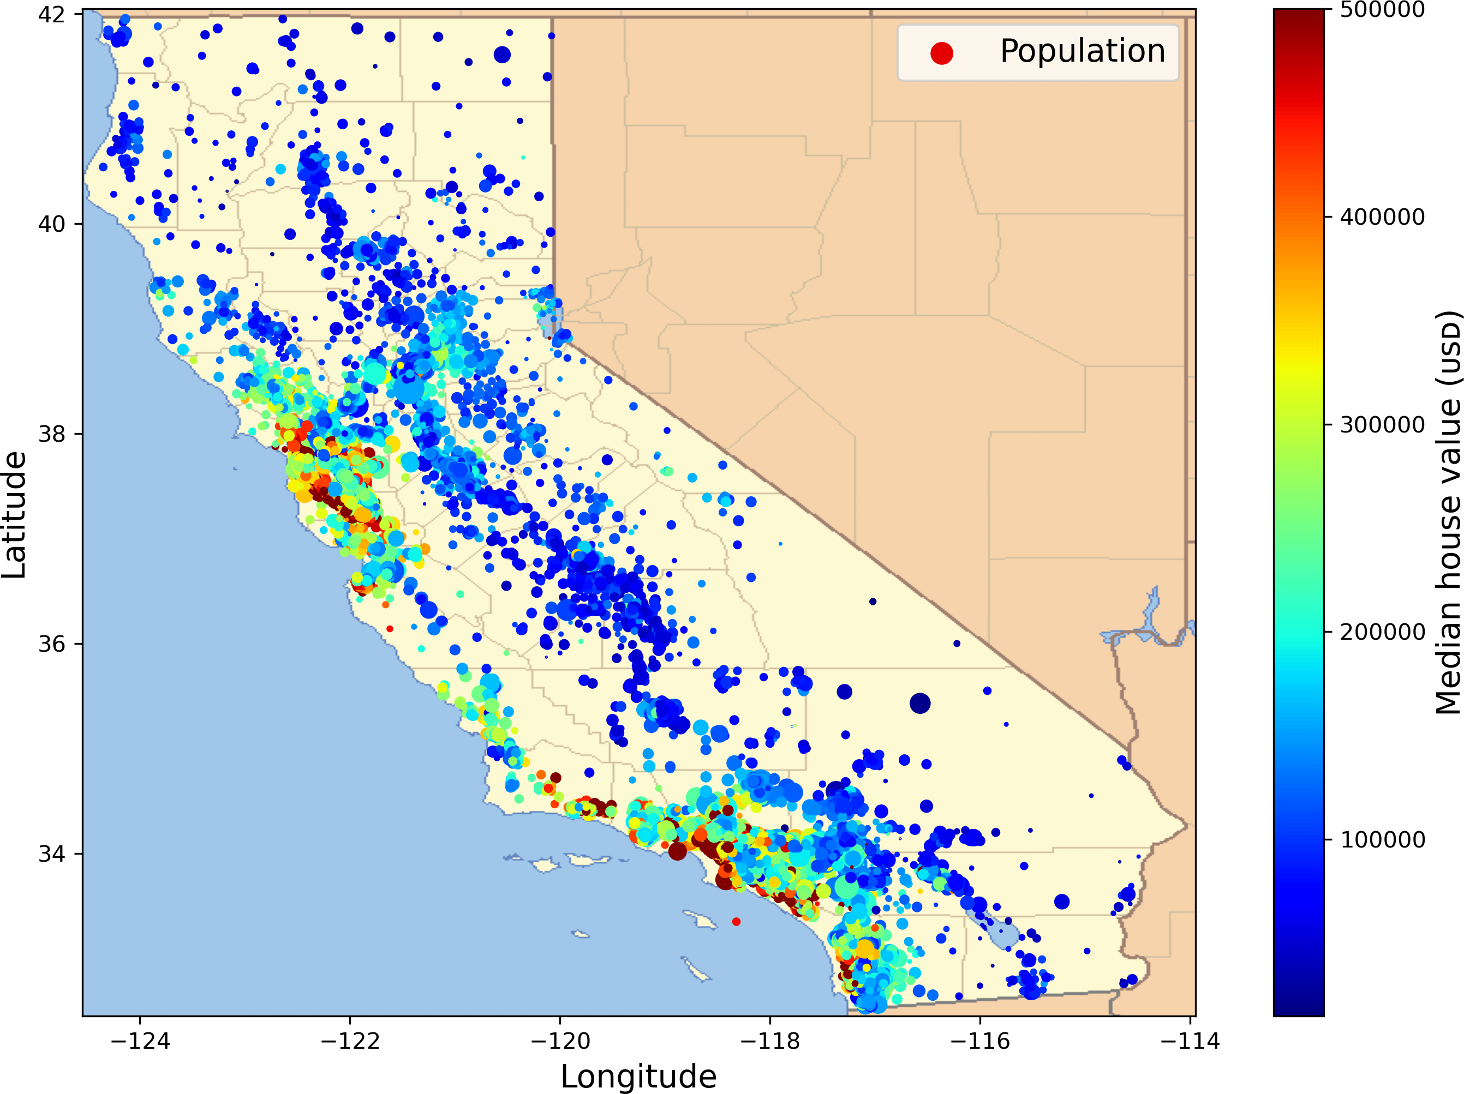
Evaluate the project
Welcome to the Machine Learning Housing Corporation! Your first task is to use California census data to build a model of housing prices in the state
This data includes metrics such as the population, median income, and median housing price for each block group in California. Each observation represents a ‘district’
Your model should learn from this data and be able to predict the median housing price in any district, given all the other metrics
Master in Quantitative Economic Analysis MQuEA
Universidad Autónoma de Madrid

Slide 5
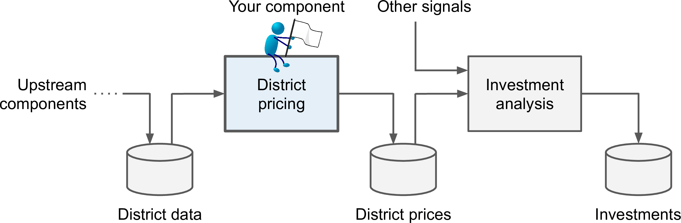
Evaluate the project
What will the model be used for? Evaluate investments
How the current solution looks like? It is currently done by experts
Frame the problem: Supervised learning, multiple regression, univariate regression, batch learning
How will we evaluate the performance of our solution (RSME,MAE, Recall, F1…)?
Master in Quantitative Economic Analysis MQuEA
Universidad Autónoma de Madrid

Slide 6
Set up your environment
Local: You have everything (data, code, etc) in your computer. You open files in your computer, code in your computer, store results in your computer… And you share attaching files to emails ☹
Server: You connect to a server, and everything you do is actually done in the server. If you launch a script, it runs in the server
Cloud: Similar than Server (in practical terms), but it is not your company’s server, it’s Amazon’s, Azure’s,… Everything you do is executed there. Why paying for an expensive machine when you can have running time at cents?
Master in Quantitative Economic Analysis MQuEA
Universidad Autónoma de Madrid

Slide 7
The workflow of a project
Setting up (pre-define parameters, write useful functions, etc)
Getting the data
Download
Quick look
Create a test set
Visualizing for first insights
Geographical (if possible)
Correlations
Some combinations that might make sense
Master in Quantitative Economic Analysis MQuEA
Universidad Autónoma de Madrid

Slide 8
The workflow of a project
Preparing data for algorithms
Cleaning
Deal with text
Categories
Transformers
Pipelines!
Training a model
Fine-tuning
Grid search/Random search
Evaluate on test set
Master in Quantitative Economic Analysis MQuEA
Universidad Autónoma de Madrid

Slide 9
Case study: California Housing Prices
We will work in the cloud!*
Download notebooks from my github repository (https://github.com/JavierBas/IMLEF-MQuEA) to your google drive
Open the notebooks in Google Colab
Play around! Everything will run in Google’s servers
Let’s do so and take a look at this comprehensive example on housing prices in the sunny State of California (Topic 2 – A Machine Learning Project.ipynb)
*Let me know if you prefer to work in local
(and I’ll convince you not to)
Master in Quantitative Economic Analysis MQuEA
Universidad Autónoma de Madrid

